Slide 1
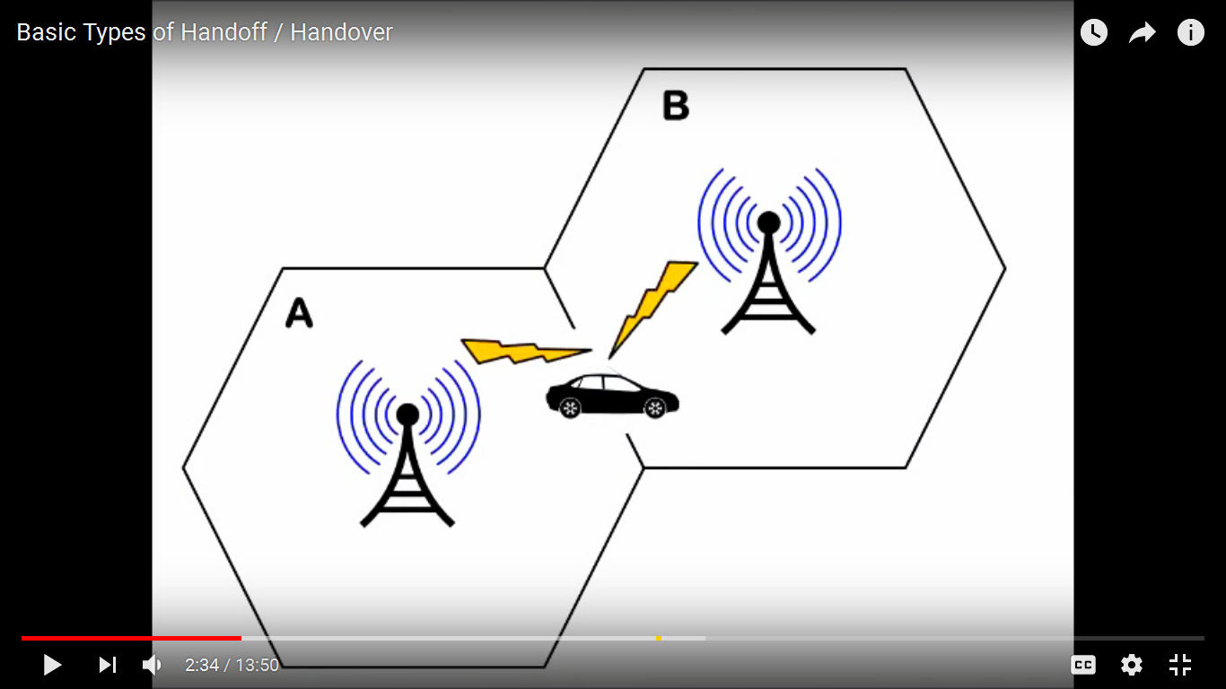
Handoff
HANDOFF
Unit 1

Slide 2
Handoff
Handoff is the process of changing the channel (frequency, time slot, spreading code, or combination of them) associated with the current connection while a call is in progress.
It is often initiated either by crossing a cell boundary or by a droping in quality of the signal in the current channel.
Also called as ‘Handover’.

Slide 3
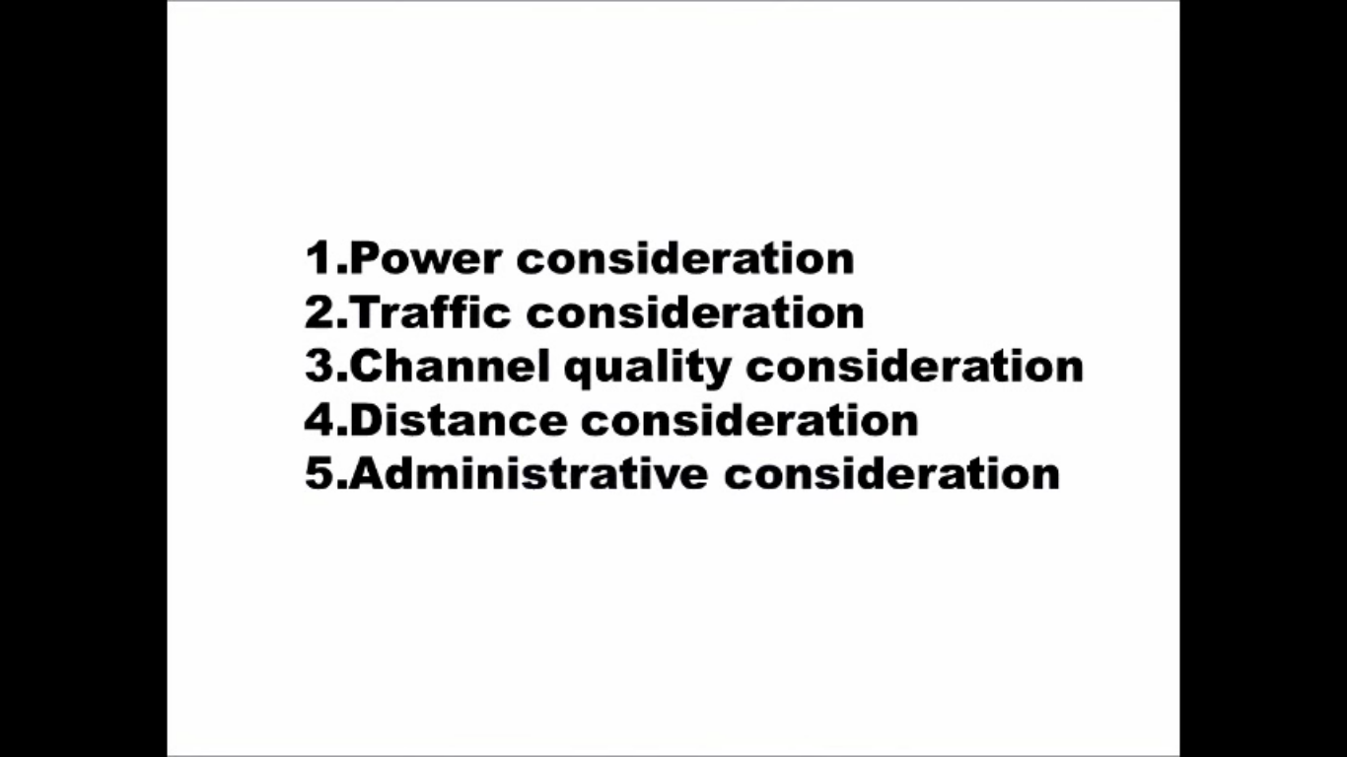
Why Need of Handover/Handoff

Slide 4
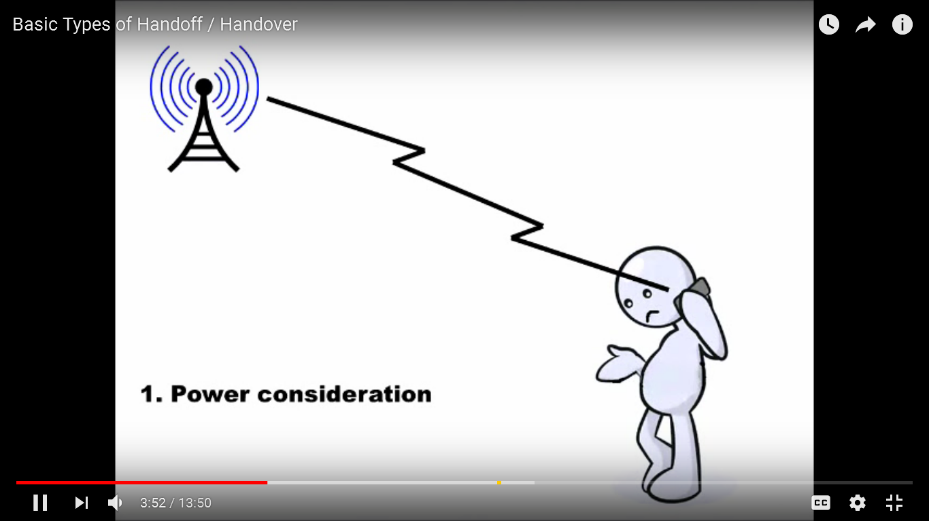

Slide 5
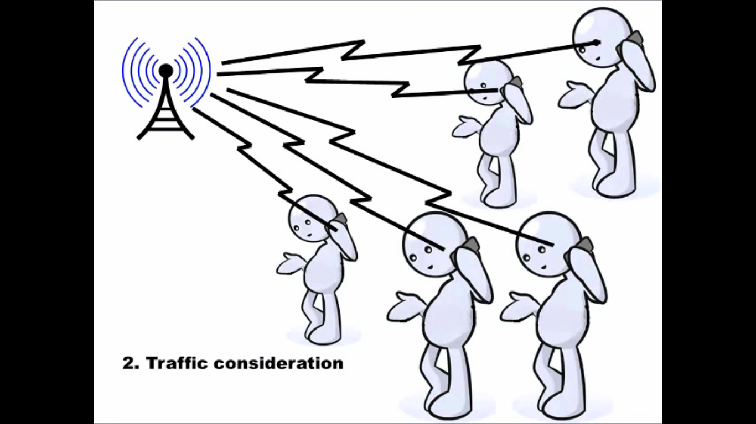

Slide 6
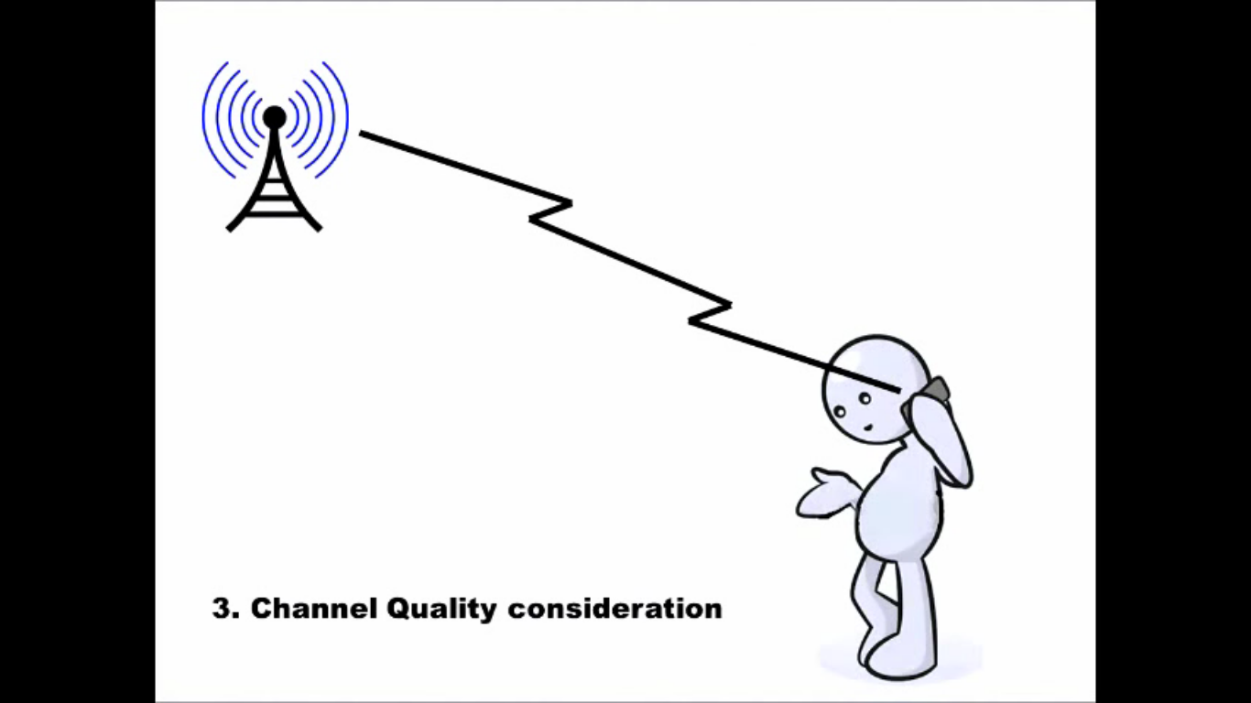

Slide 7
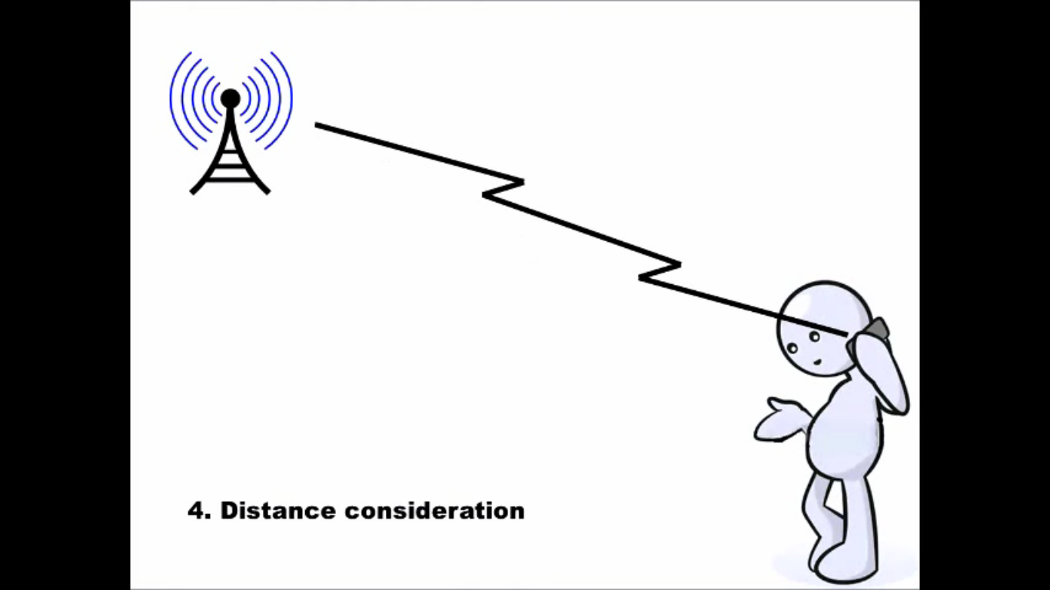

Slide 8
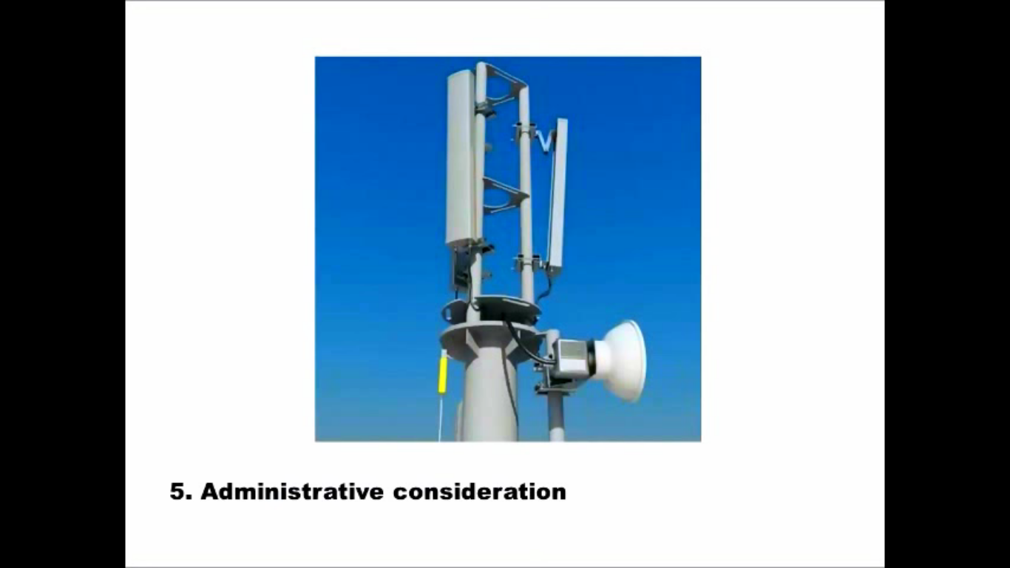

Slide 9
Reasons for Handoff
When the phone is moving away from the area covered by one cell and entering the area covered by another cell the call is transferred to the second cell in order to avoid call termination when the phone gets outside the range of the first cell;

Slide 10
Reasons for Handoff
In non-CDMA networks when the channel used by the phone becomes interfered by another phone using the same channel in a different cell, the call is transferred to a different channel in the same cell or to a different channel in another cell in order to avoid the interference;

Slide 11
Reasons for Handoff
In CDMA networks a handover may be induced in order to reduce the interference to a smaller neighboring cell due to the "near-far" effect even when the phone still has an excellent connection to its current cell;

Slide 12
Dwell Time
The time over which a call may be maintained within a cell, without handoff is Dwell time.
Dwell time vary greatly, depending on the speed of the user and the type of radio coverage
It is governed by various factors like:
Propagation
Interference
Distance between subscriber and user

Slide 13
Types of Handoff
Handoffs are broadly classified into two categories
Hard handoffs
Intracell handoffs
Intercell handoffs
Soft handoffs
Multiway soft handoffs
Softer handoffs

Slide 14
Hard Handoff
A hard handoff is essentially a “break before make” connection.
Under the control of the MSC, the BS hands off the MS’s call to another cell and then drops the call.
In a hard handoff, the link to the prior BS is terminated before or as the user is transferred to the new cell’s BS; the MS is linked to no more than one BS at any given time.
Hard handoff is primarily used in FDMA and TDMA where different frequency ranges are used in adjacent channels in order to minimize channel interference.

Slide 15
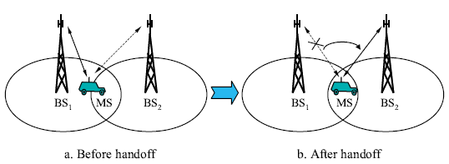
Hard Handoff
So when the MS moves from one BS to another BS, it becomes impossible for it to communicate with both BSs (since different frequencies are used).

Slide 16
HANDOFF DECISION
The decision-making process of handoff may be centralized or decentralized
From the decision process point of view, one can find at least three different kinds of handoff decisions.
Network-Controlled Handoff
Mobile-Assisted Handoff
Mobile-Controlled Handoff

Slide 17
Network-Controlled Handoff
In a network-controlled handoff protocol, the network makes a handoff decision based on the measurements of the MSs at a number of BSs.
Network-controlled handoff is used in first-generation analog systems such as AMPS, TACS and NMT.

Slide 18
Mobile-Assisted Handoff
In a mobile-assisted handoff process, the MS makes measurements and the network makes the decision.
In the circuit-switched GSM, the BSC is in charge of the radio interface management.
This mainly means allocation and release of radio channels and handoff management.

Slide 19
Mobile-Controlled Handoff
In mobile-controlled handoff, each MS is completely in control of the handoff process.
This type of handoff has a short reaction time
A handoff can be initiated if the signal strength of the serving BS is lower than that of another BS by a certain threshold.

Slide 20
Soft Handoff
A soft handover is one in which the channel in the source cell is retained and used for a while in parallel with the channel in the target cell.
In this case the connection to the target is established before the connection to the source is broken, hence this handover is called make-before-break.
The interval, during which the two connections are used in parallel, may be brief or substantial.
For this reason the soft handover is perceived by network engineers as a state of the call, rather than a brief event.
When a call is in a state of soft handover, the signal of the best of all used channels can be used for the call at a given moment or all the signals can be combined to produce a clearer copy of the signal.

